Slide 1
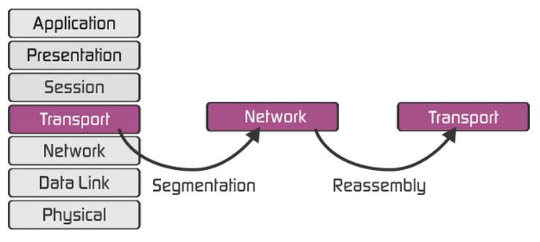
Transport layer roles & services:
Heart of OSI
Segmenting data/ Re assembling segments
Handles errors and data losses.
Protocols: TCP, SPX, NETBIOS,
ATP ,NWLINK.
Network devices: Router,
Gateway

Slide 2
Port address & Port number
An address is needed to choose among multiple processes running on the destination host called Port Number.
It is a 16 bit unsigned integer ranging from 0-65535.
Port number range | Port group
0-1023 | Well known ports
1024-49151 | Registered ports
49152-65535 | Dynamic ports

Slide 3
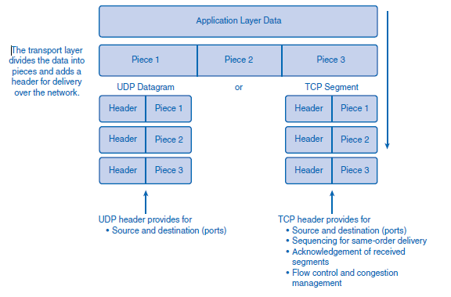
TCP and UDP

Slide 4
Differences between TCP and UDP
TCP
UDP
User Datagram Protocol
Slow
Reliable connection oriented(must be established prior to transmission)
Stream based data sent by the application with no particular structure.
Transmission Control Protocol
High speed
Un reliable [Connection less (data sent without setup)]
Message based data sent in discrete packages by application

Slide 5
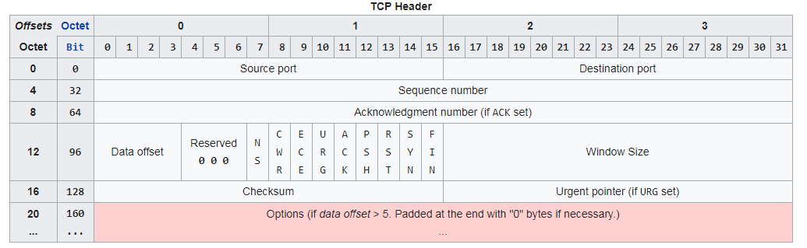
Application and Operation of TCP Mechanisms
Transmission Control Protocol accepts data from a data stream, divides it into chunks, and adds a TCP header creating a TCP segment.

Slide 6
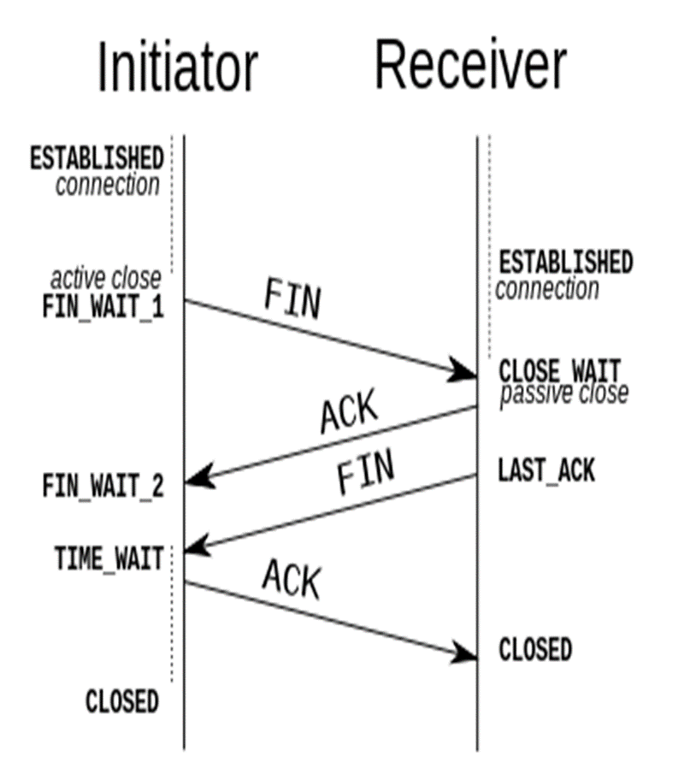
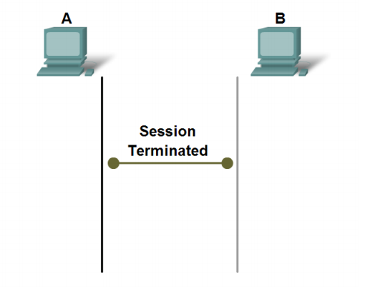
CONNECTION ESTABLISHMENT & TERMINATION

Slide 7
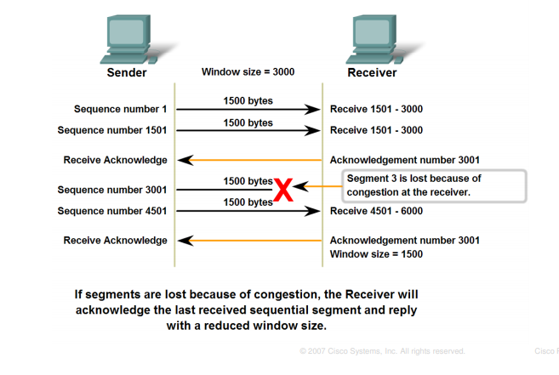
MANAGING TCP SESSIONS
TCP uses an end-to-end flow control protocol to avoid having the sender send data too fast for the TCP receiver to receive and process it reliably
The final main aspect of TCP is congestion control.

Slide 8
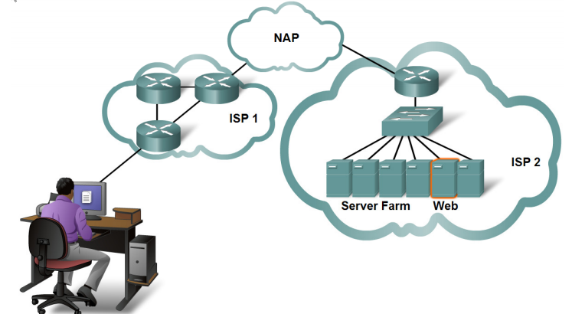
TCP Retransmission
TCP will judge the need for a retransmission based on the RTO or the retransmission timeout. If the packet never receives an ACK in the time frame set, it's retransmitted.
The time between the two packets
is called the round-trip time.
Every time a retransmit happens,
the RTO for that packet doubles.

Slide 9
UDP protocol
The main characteristics of the UDP service are :
The UDP service cannot deliver SDUs that are larger than 65467 bytes
The UDP service does not guarantee the delivery of SDUs (losses and desquencing can occur)
The UDP service will not deliver a corrupted SDU to the destination

Slide 10
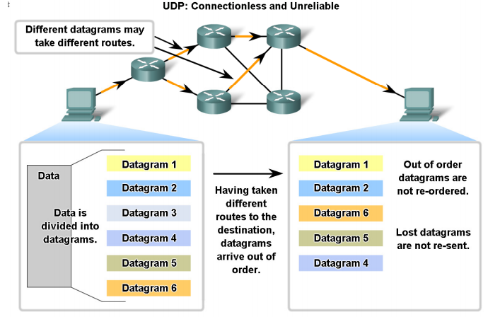
process specified by the UDP protocol to reassemble PDUs at the destination device

Slide 11
NETWORK LAYER
The layer that provides data routing paths for network communication. Data is transferred in the form of packets via logical network paths in an ordered format controlled by the network layer.
Network layer mainly responsible for:
IP (Internet protocol)
Routing, which is moving packets
Other protocols include ICMP, IPsec, ARP, RIP, OSPF and BGP.

Slide 12
Ipv4 ipv6
IPv4 uses a 32-bit address scheme allowing for a total of 2^32 addresses (just over 4 billion addresses).
IPv6 is the successor to Internet Protocol Version 4 (IPv4). It was designed as an evolutionary upgrade to the Internet Protocol .
In fact, coexist with the older IPv4 for some time. IPv6 is designed to allow the Internet to grow steadily, both in terms of the number of hosts connected and the total amount of data traffic transmitted.

Slide 13
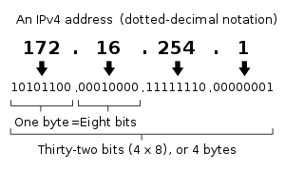
Ipv4 notation

Slide 14
Routing
Routers are devices that connect networks.
Routing is theprocess routers perform when receiving packets, analyzing the destination address information.
Using the address information to select a path for the packet, and then forwarding the packet on to the next router on the selected network.
Each route that a packet takes to reach the next device is called a hop
Types:
Static routing
Dynamic routing

Slide 15
TYPES OF ROUTING
Static Routing
The route information can be manually configured on the router, creating what is known as a static route
Dynamic Routing
Routers can also learn about routes automatically from other routers in the same internetwork,which is known as dynamic routing.

Slide 16
Packet forwarding
Routing is performed packet by packet and hop by hop. Each packet is treated independently by each router along the path.The router will then do one of the following with the packet:
■ Forward it to the next-hop router
■ Forward it to the destination host
■ Drop it

Slide 17
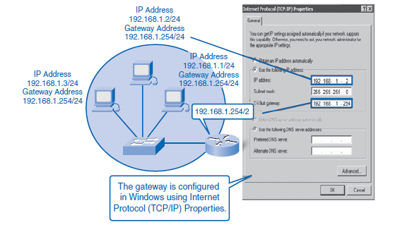
Default gateway
IP address of the interface on the router that connect to the network segment on which the source host is located.

Slide 18
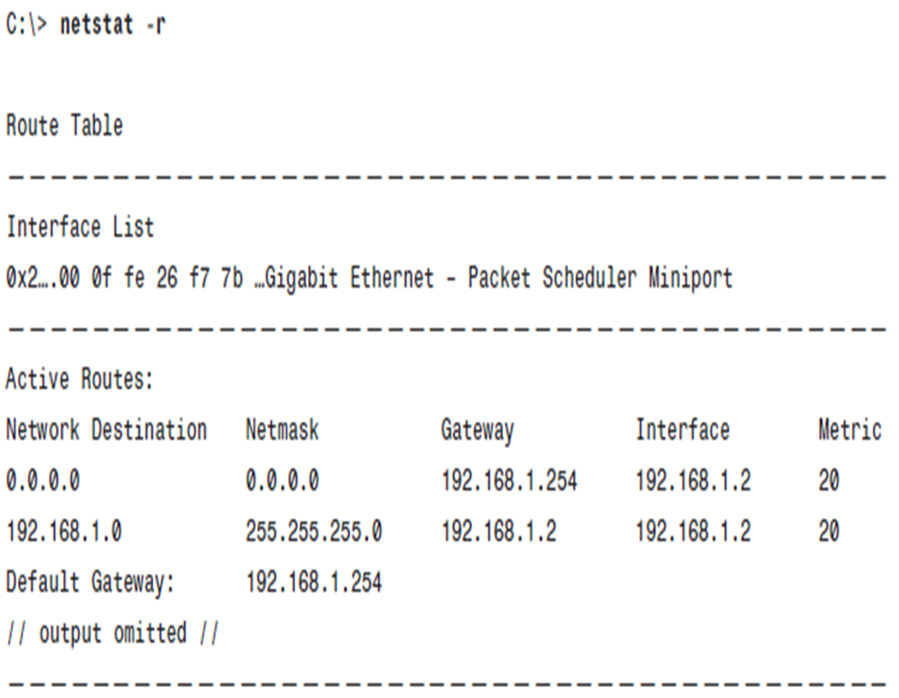
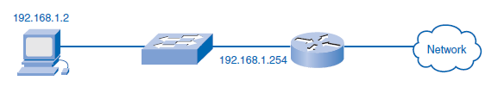
Host Routing Table
Hosts require a local routing table to ensure that network layer packets are directed to the correct destination network.

Slide 19
Default routes
Routes in a routing table have three main features:
■ Destination network
■ Next-hop
■ Metric

